Slide 1





Course Name object oriented analysis and design
CSC 2210
(Undergraduate)
Software engineering (Undergraduate)
Chapter 5 activity diagram
Victor Stany Rozario
Assistant Professor
Department of Computer Science, AIUB
Web: https://cs.aiub.edu/profile/stany

Slide 2
process
OOAD : Activity Diagram
Victor Stany Rozario
OOAD : Activity Diagram
Victor Stany Rozario
S.2
A process is a collection of related tasks that transforms a set of inputs into a set of outputs.
Process description notations describe design processes as well as computational processes we design.
An activity is a non-atomic task or procedure decomposable into actions.
An action is a task or procedure that cannot be broken into parts.

Slide 3
Activity diagram
OOAD : Activity Diagram
Victor Stany Rozario
S.3
Describes activities and flows of data or decisions between activities
Provides a very broad view of business processes
Can be used to break out the activities that occur within a use case
Commonly shows many different activities that will be handled by lots of different symbols
Good for showing parallel threads
Activity diagrams can be used in conjunction with other modeling techniques such as interaction diagrams and state diagrams

Slide 4
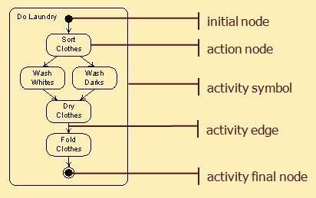
Activity graph elements
OOAD : Activity Diagram
Victor Stany Rozario
S.4

Slide 5
Execution model
OOAD : Activity Diagram
Victor Stany Rozario
S.5
Execution is modeled by tokens that are produced by action nodes, travel over action edges, and are consumed by action nodes.
When there is a token on every incoming edge of an action node, it consumes them and begins execution.
When an action node completes execution, it produces tokens on each of its outgoing edges.
An initial node produces a token on each outgoing edge when an activity begins.
An activity final node consumes a token available on any incoming edge and terminates the activity.

Slide 6
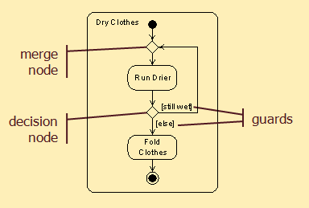
Branching Nodes Execution
OOAD : Activity Diagram
Victor Stany Rozario
S.6
Incoming -2
Outgoing - 1
Incoming -1
Outgoing - 2

Slide 7
Branching Execution
OOAD : Activity Diagram
Victor Stany Rozario
S.7
If a token is made available on the incoming edge of a decision node (join if…else condition), , the token is made available on the outgoing edge whose guard is true.
Guards must be mutually exclusive (the outgoing signal is transfer to either true or false, but not both)
If a token is available on any incoming edge of a merge node (join parallel actions), it is made available on its outgoing edge.

Slide 8
Deadlock
OOAD : Activity Diagram
Victor Stany Rozario
S.8
RunDrier cannot execute: when the activity begins, there is a token on the edge from the initial node but not on the other incoming edge.

Slide 9
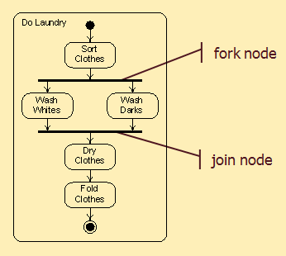
Forking & joining nodes
OOAD : Activity Diagram
Victor Stany Rozario
S.9
A token available on the incoming edge of a fork node is reproduced and made available on all its outgoing edges.
When tokens are available on every incoming edge of a join node, a token is made available on its outgoing edge.
Concurrency is modeled of these nodes.

Slide 10
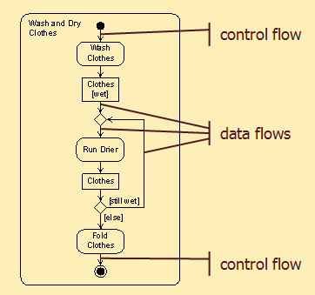
Object nodes
OOAD : Activity Diagram
Victor Stany Rozario
S.10
Data and objects are shown as object nodes (represented by noun and its state in a rectangular box)
Control tokens do not contain data, data tokens do.
A control flow is an activity edge that is a channel for control tokens.
A data flow is an activity edge that is a channel for data tokens.
Rules for token flow through nodes apply to both control and data tokens, except that data is extracted from consumed tokens and added to produced tokens.

Slide 11
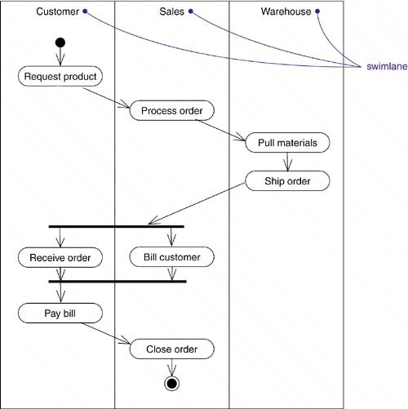
Swimlane
OOAD : Activity Diagram
Victor Stany Rozario
S.11
Modeling workflows of business processes, to partition the activity states on an activity diagram into groups, each group representing the business organization responsible for those activities. Each swim lane has a name unique within its diagram. A swim lane really has no deep semantics, except that it may represent some real-world entity, such as an organizational unit of a company.

Slide 12
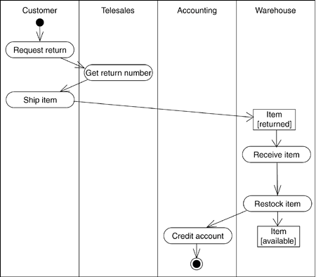
Object Flow
OOAD : Activity Diagram
Victor Stany Rozario
S.12
Objects may be involved in the control flow associated with an activity. Usually how the state of object changes is shown with object flow.

Slide 13
Activity diagram heuristics
OOAD : Activity Diagram
Victor Stany Rozario
S.13
Flow of control and objects goes down the page and from left to right.
Name activities and actions with verb phrases.
Name object nodes with noun phrases.
Use the [else] guard at every branch.
When to Use Activity Diagram
When making a dynamic model of any process.
Design processes (what designers do)
Designed processes (what designers create)
During analysis
During resolution (decision)

Slide 14
Case Studies
OOAD : Activity Diagram
Victor Stany Rozario
S.14
Case 1
In an online movie ticket booking system a customer books ticket using an interface. After the customer places a request for current movies he waits for the information. While the customer is waiting the server creates a Session object which then requests a list of currently running movies from the movie database. The list is then sent to customer. Customer then selects the desired movie and the Session object retrieves the available timing of the selected movie. Before displaying the time to the customer each scheduled time of the movie is checked in the Booking Database for the availability of the seats. Only the time schedules in which seats are available are displayed to the customer. The customer then selects the number of seats he wants to book. The rate of the ticket is taken from the Movie Database and the due amount is calculated by the Session object. Then the customer enters his credit card detail for the calculated amount which is verified by a credit Card Agent. If the card is verified the session object sends a receipt to the customer, writes in the booking database and update the movie database at the same time. If the card is not verified the customer request is denied. The server finally destroys the session object.

Slide 15
Case Studies
OOAD : Activity Diagram
Victor Stany Rozario
S.15
Case 2
In an online airlines ticket booking system, a customer places a request to the system selecting the departure and arrival destinations and also the date of departure. The system then gets all the carrier names and their time schedule from the flight database. Once the carrier names and their time schedules are received the system displays the options of the carriers and the schedule to the customer. If the customer likes any one of the options, he selects the option. But, if the customer doesn’t like any option he can go back and select a new date of departure or he can close the application. After selecting an option, the system asks for customer details and credit card information. The system verifies the credit card. If the credit card is valid, the system writes all the booking information in the booking database and sends customer information to the carrier simultaneously. If the verification of the credit card fails, the system sends an error message to the customer and requests for credit card information again. The verification process is done again. If the credit card verification fails for three times the system cancels the booking process and sends a warning message to the credit card agent at the same time. Once the booking is done the system passes the message to the interface and the interface generates a bill and sends it to the customer.

Slide 16
Case Studies
OOAD : Activity Diagram
Victor Stany Rozario
S.16
Case 3
In an ATM machine a customer starts a withdrawal transaction by inserting the card. Then he enters the pin, which is verified by the bank. If the pin is incorrect the machine requests for the pin again and the customer enters pin number. The verification repeated for 3 times for an incorrect pin number. If the pin is incorrect even in 4th attempt, the card is seized by the machine and the transaction is closed. If the pin is correct customer enters the amount he wishes to withdraw. The bank then checks the account balance of the customer. If the balance is greater than or equals to the withdrawal amount then money is dispatched through the machine and the information is written in the log concurrently. If the money is taken form the slot within 5 seconds, the account is debited and a transaction receipt is printed simultaneously. If money is not taken in 5 seconds, it is taken back by the machine. Then the balance is shown to the customer. The card and the receipt are then ejected at the same time, and the transaction is completed.

Slide 17
references
OOAD : Activity Diagram
Victor Stany Rozario
S.17
Booch, G., Rumbaugh, J. & Jacobson, I. (2005). The unified modeling language user guide. Pearson Education India.

